Slide 1
macOS Sierra Upgrade Walkthrough
TEMPO 2.0

Slide 2
Important Information
Objective
To provide a screen by screen walkthrough of a typical upgrade process during the execution of TEMPO 2.0 as part of a Sierra upgrade.
Requirements
Intel based Mac running OS X 10.10 “Yosemite” or OS X 10.11 “El Capitan”
Functional local account with administrator rights
Functional user account in Active Directory
Known-good backup (just in case)
Wired connection to the TE Connectivity corporate network
Note: Do not attempt this upgrade of a VPN connection. During the process, you WILL temporarily lose VPN access to the TE network.

Slide 3
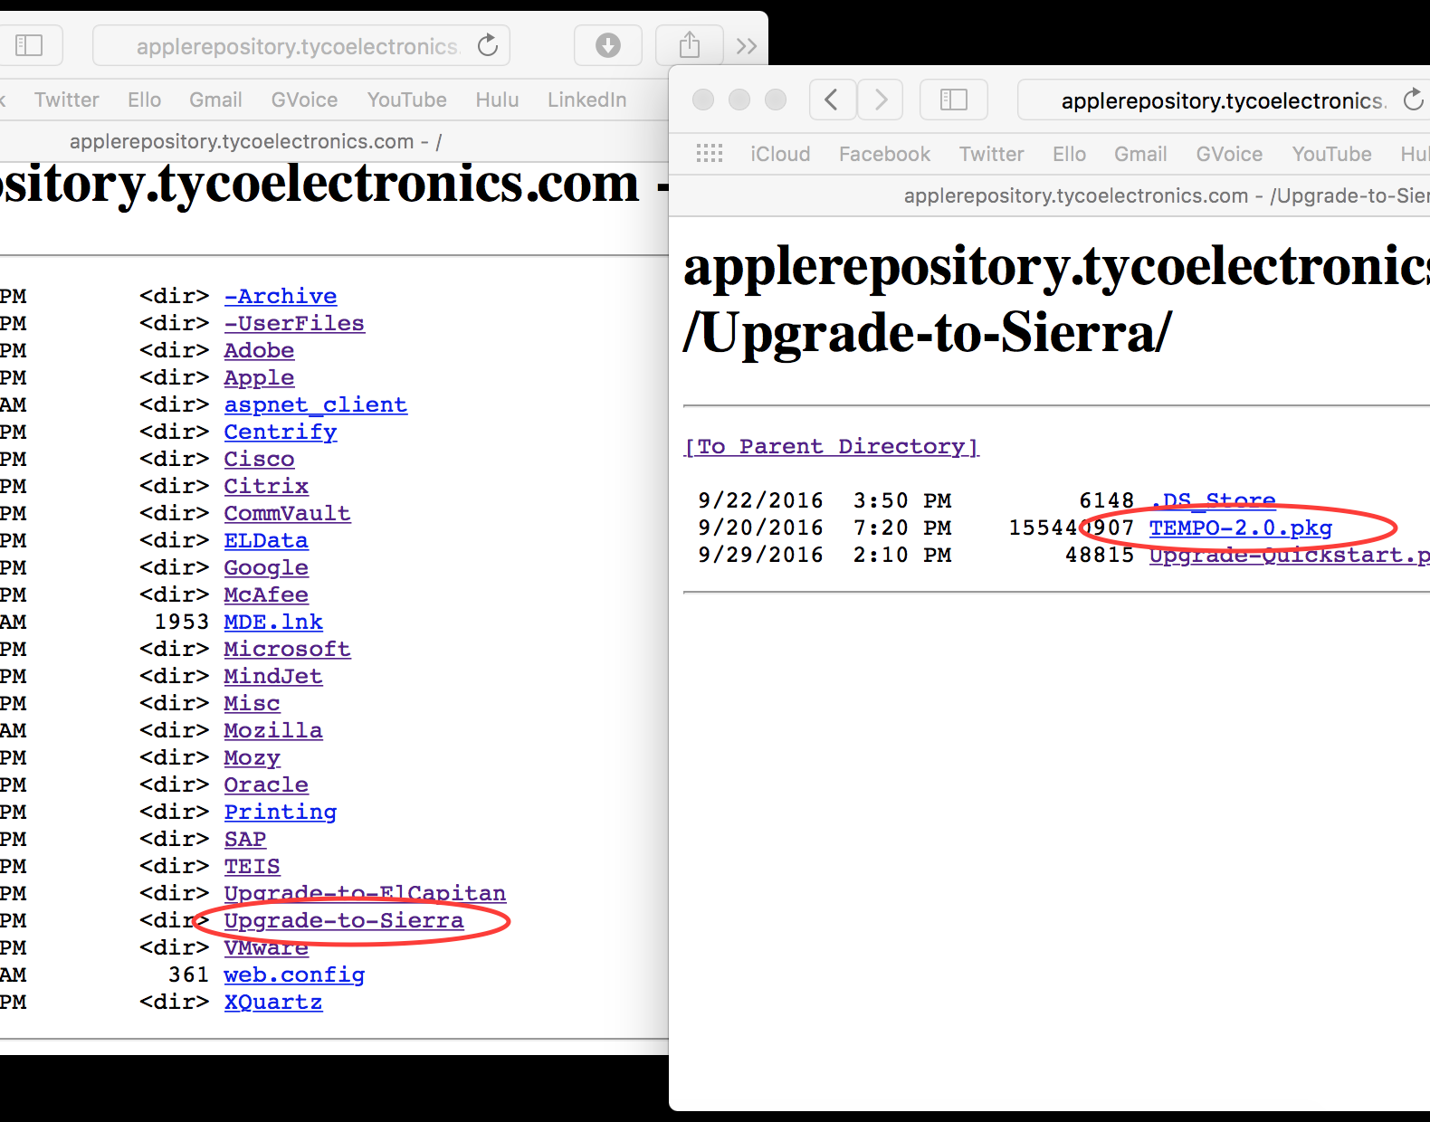
1. Download TEMPO
Navigate to: http://applerepository.tycoelectronics.com
Download TEMPO 2.0 from within the “Upgrade to Sierra” folder.

Slide 4
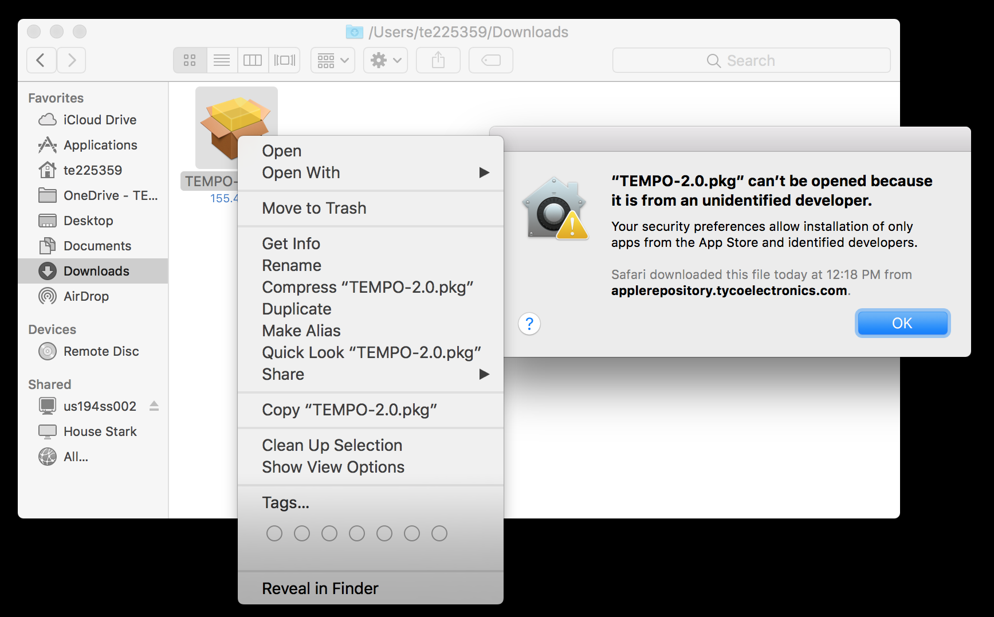
Launch TEMPO
Locate TEMPO-2.0.pkg in your Downloads folder
Double-clicking on the icon will display a Gatekeeper alert, which will prevent you from opening the file.
Secondary-Click on the icon, and select Open from the list that appears.

Slide 5
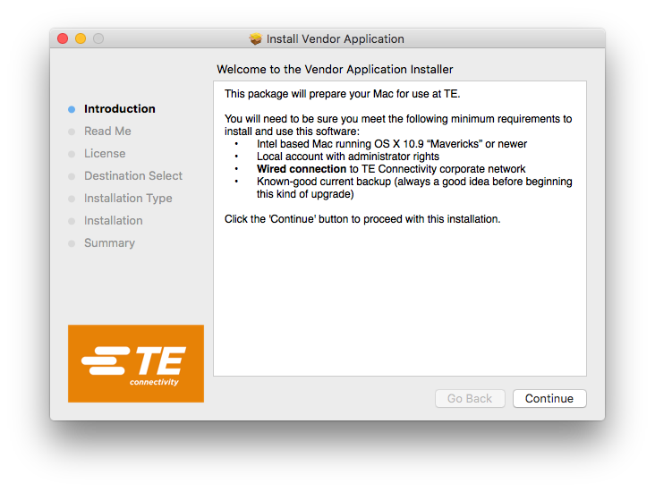
Welcome Screen
You will be presented with an Installer screen.
The minimum requirements to run this package will be presented.
If you do not meet these minimum requirements, you will be presented with an alert message preventing you from continuing with the installation.
Click Continue to proceed.

Slide 6
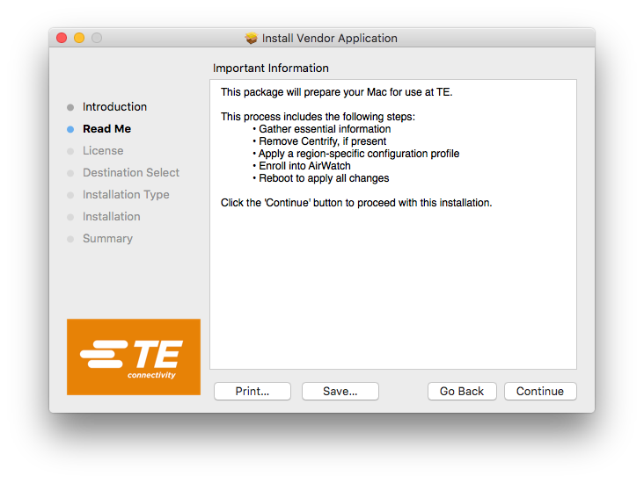
Important Information Screen
You will then be presented with an overview of the steps the installer will perform.
Click Continue to proceed.

Slide 7
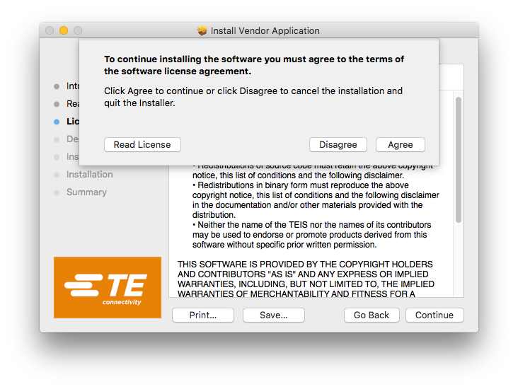
License Agreement
The next screen will display a general license agreement covering the components included in the installation.
Click Continue to proceed.
A confirmation sheet will be displayed, Click Agree to proceed.

Slide 8
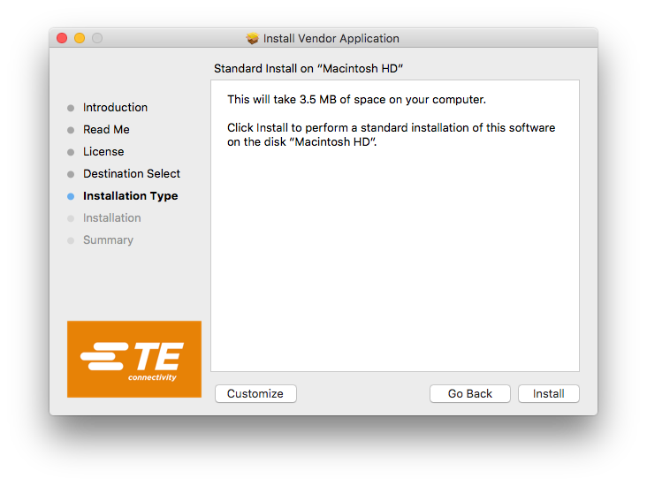
Installation Type Selection
A screen informing you of the space required to complete the installation will be presented.
Click Install to proceed with a standard installation.
Click Customize to further refine installation options.

Slide 9
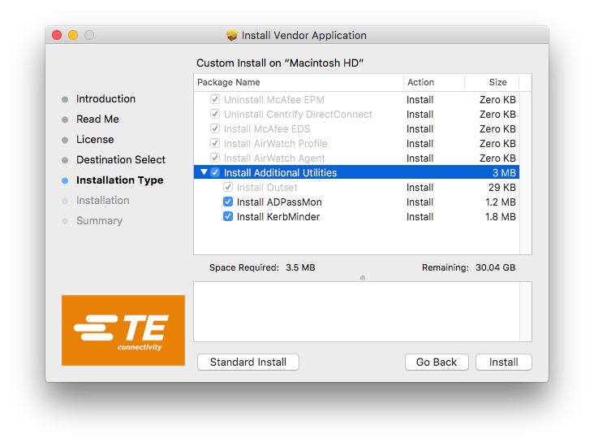
Custom Install
Most installation components are required, but you have the option to not install ADPassMon or KerbMinder if you would prefer not to.
Click Install to proceed with the selected installation options.
Click Standard Install to return to the HD space requirement screen and proceed with a default installation.

Slide 10
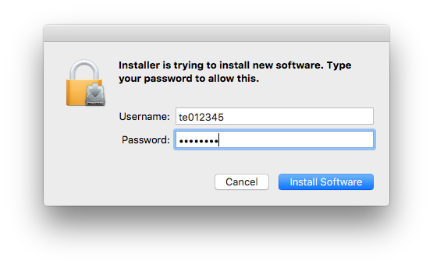
Admin Credentials
You will be prompted for administrative credentials.
In most cases, your AD user should already be an admin on the computer, and your Username will be pre-populated.
In some rare situations, you will need to instead enter the credentials for the local admin user.
Click Install Software to proceed

Slide 11
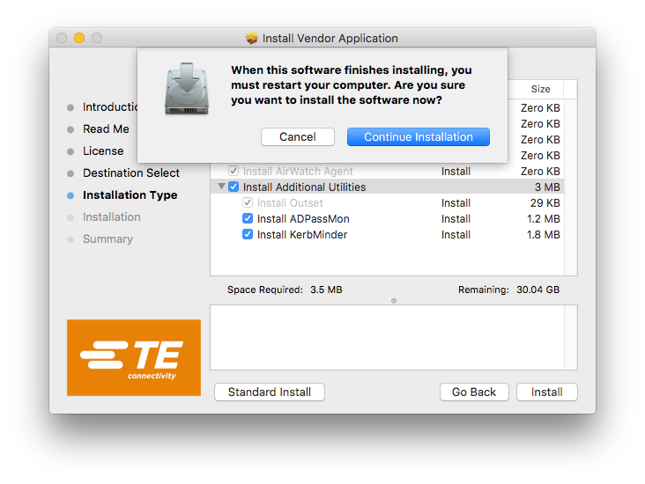
Restart Confirmation
This installation is performing several major operations on your computer, and a restart will be required to allow these modifications to take effect.
Click Continue Installation to proceed

Slide 12
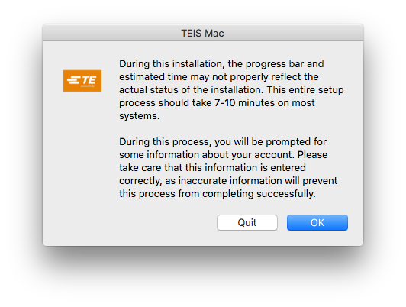
Estimated Time Dialog
Because of the nature of the scripts this installation executes, the time presented in the installer window will likely not be accurate.
Due to a limitation of the technology used to display the prompts for user information, if a response is not entered within 5 minutes an error will occur and installation will abort.
Click OK to proceed.
Click Quit to abort the installation with not changes made.

Slide 13
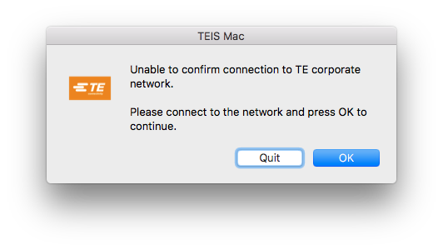
Network Check
The installation script will check that it can reach TE internal sites.
If you have recently restarted your computer, or haven’t connected to the network yet, you can take up to 5 minutes to establish a network connection before continuing.
Click OK to proceed
Click Cancel to abort the installation

Slide 14
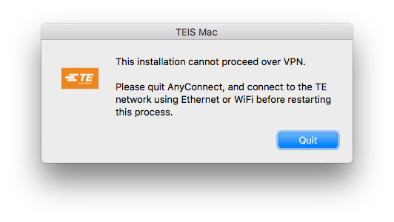
VPN Check
Because this process revokes the certificates and components that VPN uses to trust your device, it is not possible to complete the process over VPN.
If AnyConnect is found open, regardless of connection status, the installation will abort at this point.

Slide 15
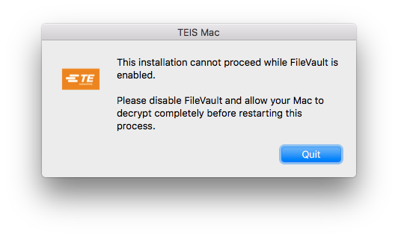
Encryption Check
During this installation, several specifics of your user account will be updated or changed. As some of these specifics are used to grant the ability to unlock an encrypted drive, encryption must be disabled before continuing.
If you were to proceed with an encrypted HD, it is likely this installation would result in there being no valid user accounts capable of unlocking the drive.

Slide 16
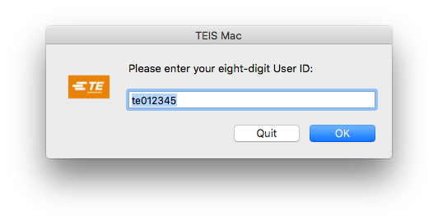
User ID Prompt
As part of this installation, data will be gathered and set to TE servers to allow your device to access the wifi network. One of the pieces of information required is your user ID.
This as an additional prompt beyond that for admin credentials, as this does needs to be a valid TE Active Directory user, regardless of that account’s admin rights on this specific machine.
Click OK to proceed
Click Quit to abort the installation

Slide 17
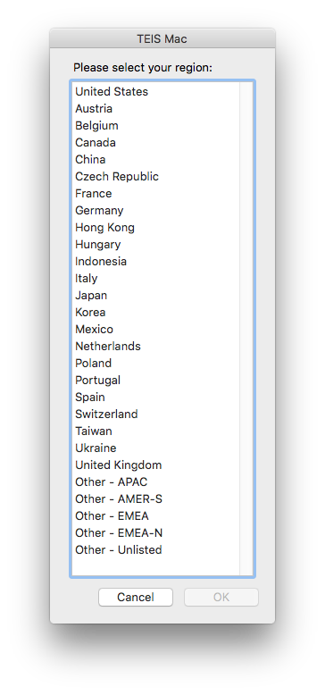
Region Selection
You will then be presented with a list of TE regional domains.
Select the region that is closest to your common location.
Your selection will govern which Enrollment Profile will be installed, and thus wish Organizational Group your device will be enrolled into and which Active Directory Domain your device will be bound to.
Click OK to proceed
Click Cancel to abort the installation

Slide 18
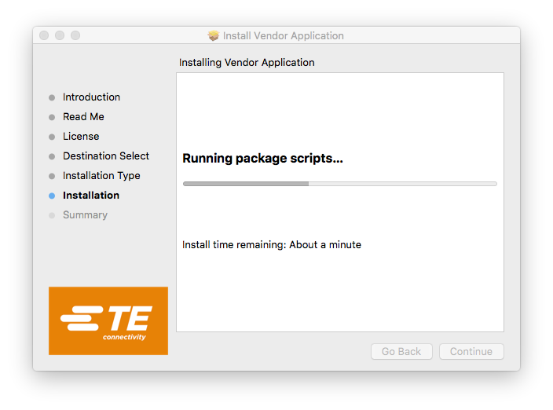
Installation Progress
After proceeding through the various pop-up notifications, a progress bar will be displayed.
As previously stated, the estimated time remaining will likely say “About a minute” even though the installation will likely take several minutes.

Slide 19
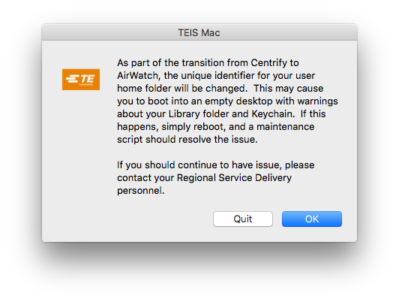
Permissions Alert Message
As previously mentioned, because of the change in binding technology that occurs during this installation, several specifics of your account.
This can result in your account no longer having access to the home folder, and may cause multiple error messages during the first boot.
In such instances an additional reboot should resolve the issue.
While the Quit button will exit the installation, the installation is effectively complete at this point. This button will be removed in future versions of this installer.
Click OK to complete the installation

Slide 20
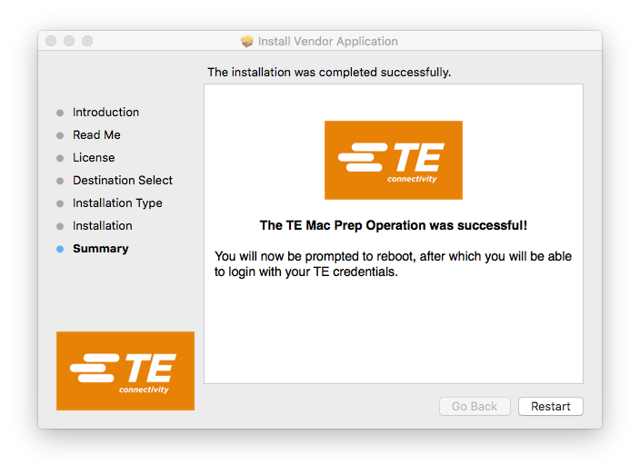
Success Message
Once the installation completes, you will be presented with the summary screen announcing the installation’s success.
Click Restart to proceed

Slide 21
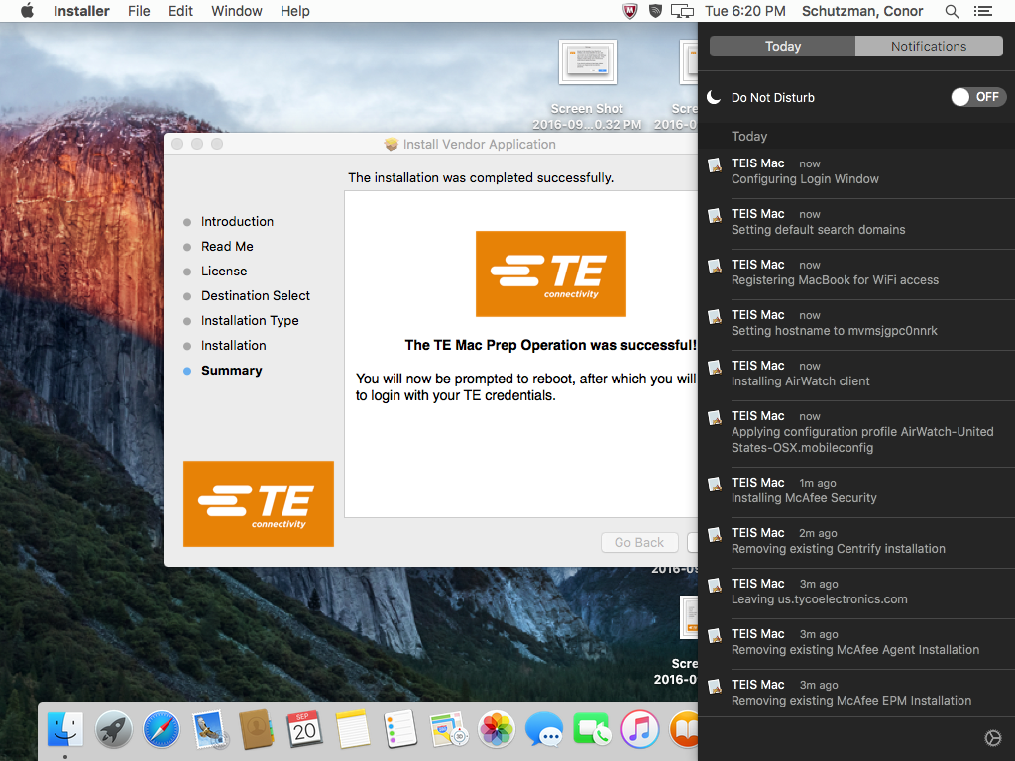
Notifications
Throughout the installation, a notification will display as each component and sub-process begins.
This progress can be monitored using the Notification Center

Slide 22
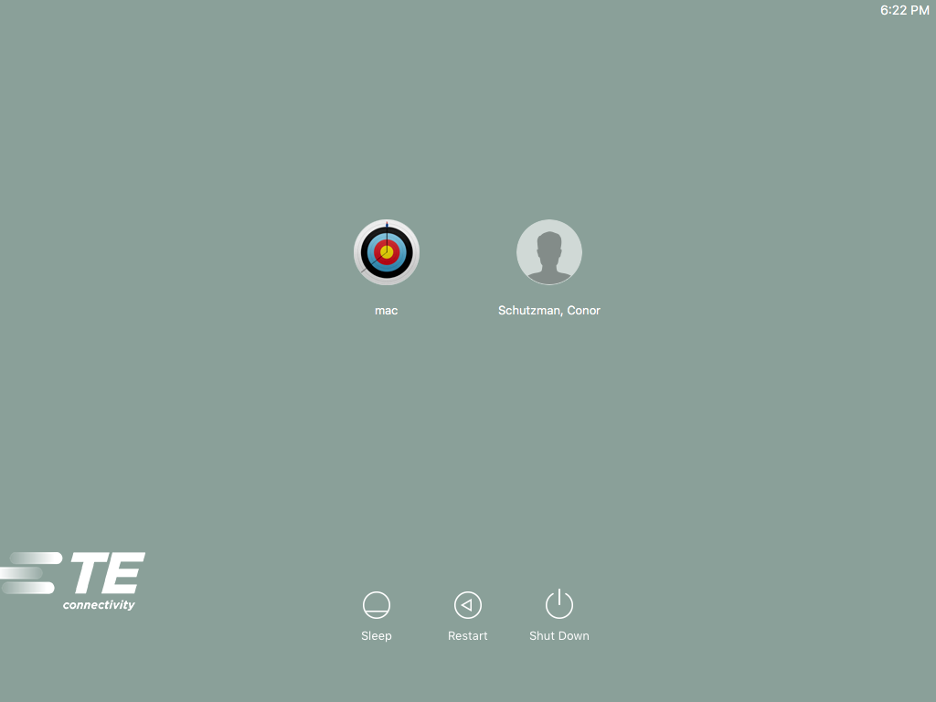
After Installation
If after installation completes and the device reboots, your login screen displays icons for available users, the enrollment process is not yet complete and profiles are likely still being pushed to the device.
You can log in, but know that the device is still in a state of flux.
It may be better to allow the device to sit at the login screen, with a connection to the TE network, for a few moments.
In some cases, depending on network configuration, you may need to reboot before profiles can be accepted and enrollment complete.

Slide 23
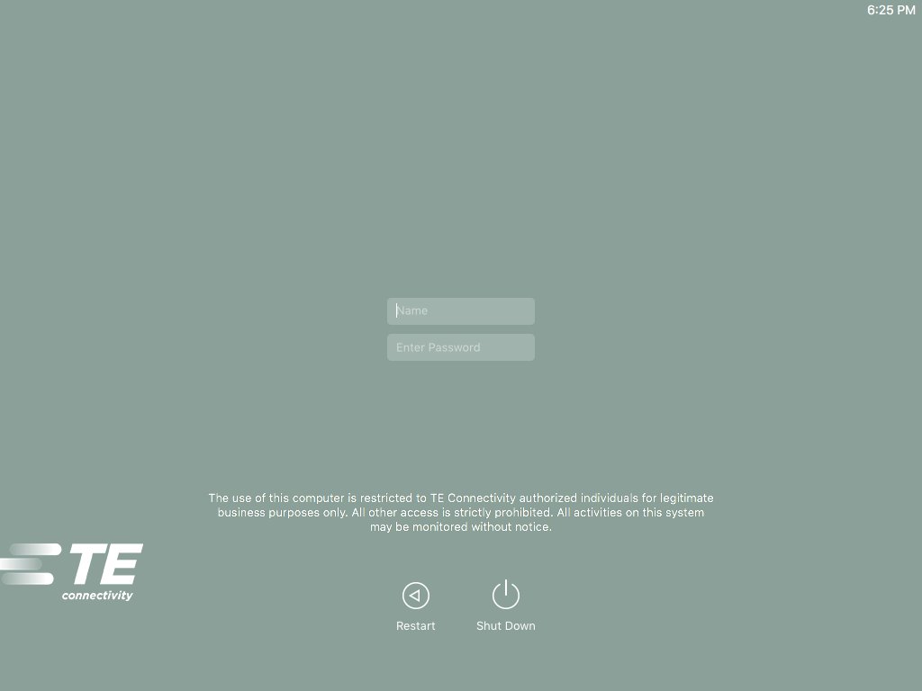
Enrollment Complete
Once enrollment is complete, and all profiles are deployed, the login window will change to be text fields, with a TE-specific usage banner.
The device should also be bound to the AD environment, so you can log in as any valid AD user, not just a user that was previously configured on the device.

Slide 24
Sierra Installation
With the preparation step complete, you can now download and install Sierra from the Mac App Store.
You do not need to be on the TE network to install the Sierra upgrade. In fact, because of the file size, it is recommended you download this upgrade off of the TE network.
You will not be able to connect via VPN until you have completed the Sierra installation, and connected to the TE network (via wired or wireless) afterwards. This process can theoretically take up to 2 hours to complete after the connection is made.

Slide 25
Additional Considerations
You may want to update your other software to ensure compatibility with Sierra
Apple Software Update in the Mac App Store in order to update any Apple applications.
Microsoft Auto Updater can be accessed through the Help menu in any Office Application.
Citrix Receiver & VMware Horizon will need to be updated from the Apple Repository before they will function under macOS Sierra.
Sierra includes new features that may pose a security risk to TE
If you use iCloud drive, be sure to either disable the “Desktop & Documents Folders” sync option, or be careful to not store any TE confidential documents in these locations.
Additional Resources
To stay informed about Mac technologies at TE, please join the Mac@Work community.
If you have any questions regarding this upgrade, please contact your local Help Desk.

